Slide 1
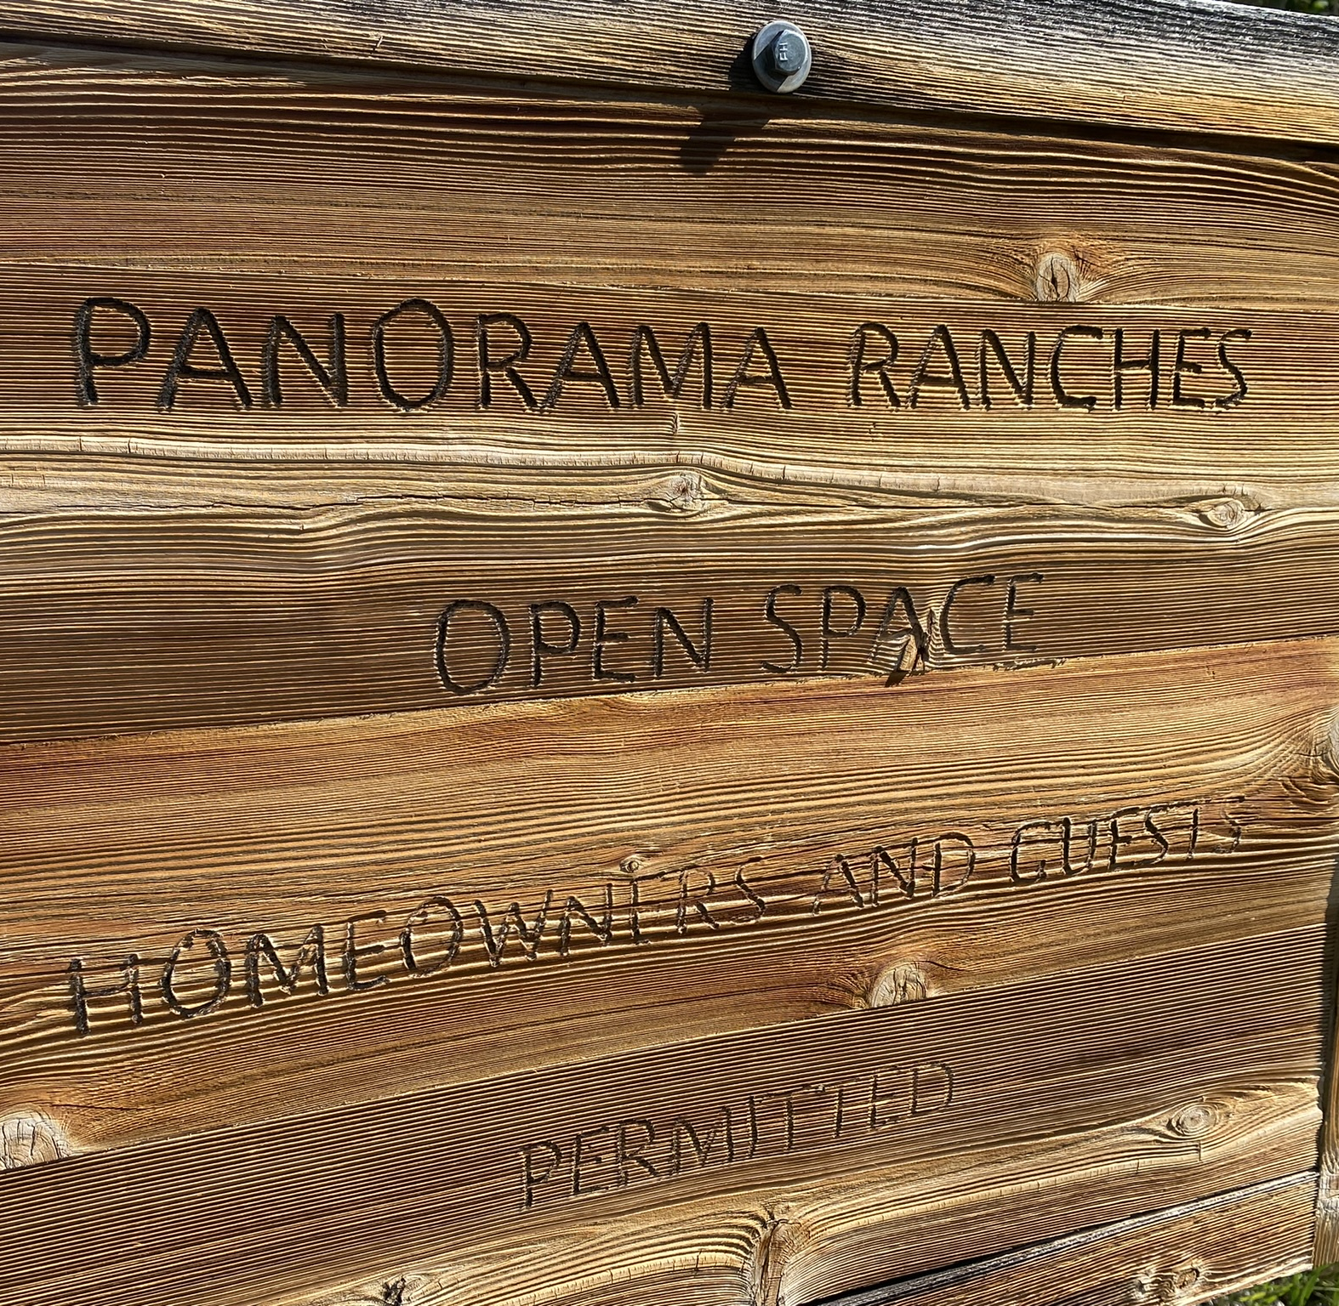
Panorama Ranches Open Space
Wayne Hall
Davis Farrar
Doug Cernonok
Dave Zamansky
Andrew Matuszeski
Sam Wallack
Henry de Gaspe de Domville Andrade
Colleen Hause
Jean Bauer

Slide 2
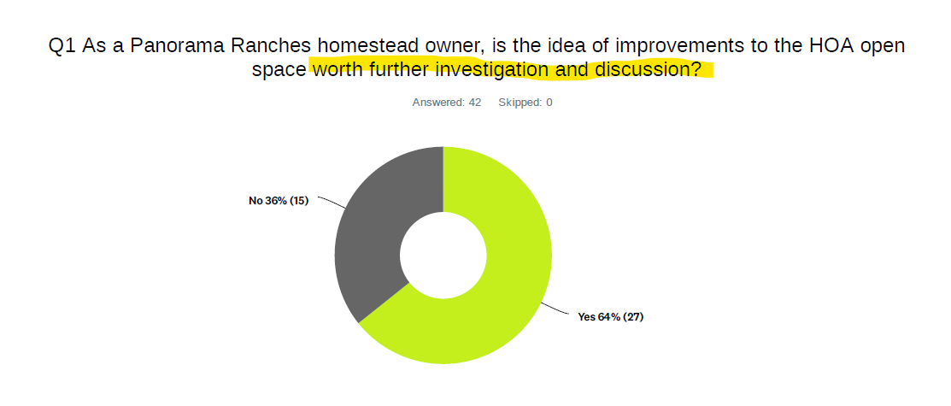
Nine owners volunteered
Proposal to create a Board Subcommittee or Task Force

Slide 3
Considerations
Mission:
To facilitate further investigation and discussion among homeowners of open space improvements, including:
Possible amenities and options (per owner input)
Risks and Benefits (understanding, mitigating risks)
Understanding costs and funding options
Present data and information to homeowners and Board to determine what amenities (if any) should be pursued
Incorporate desired amenities into a future state master plan
Board Member representation, communication, oversight?

Slide 4
~~~
Guiding Principles:
Listen / Communicate / Consider homeowner ideas and concerns
Open and Transparent to homeowners and Board
Open Space needs to remain a community asset
There is no hurry / take the time to get it right
Recognize and accept that “do nothing” may become the consensus of owners
__
__

Slide 5
Notes
Initial (rough) Task Plan:
Step Zero
Owner Opinion Survey
Step 1—Gather and Present Foundational Knowledge
Other HOAs
Realtors
County
Bylaws
CPW / State
Financial
Step 2—Ranking options
Solicit owner feedback on a variety of amenities and options
Step 3—Single Master Plan
Up/Down vote of owners on a specific master plan proposal
Board accept, reject, modify
Step 4—Phase 1 Planning and Implementation
Board only, or advisory continues?
Owner discussion and/or feedback at ALL steps
Timeline unknown (doesn’t matter)
This group’s work ends at Step 3. Step 4: Phased Implementation can be either a Board responsibility, or a new group / new charter

Slide 6
Requested Board Action:
Recognize “Open Space Advisory Subcommittee” to the Board, with the stated goals, guiding principles, and work plan
Support Subcommittee communication with homeowners in this process
Authorize access to community email list for communications necessary to complete the mission
Clarify equestrian easement
Dedicated HOA owner web portal folder
Appoint Board Member point of contact

